Slide 1
Convolutional Neural Networks on Biological sequences

Slide 2
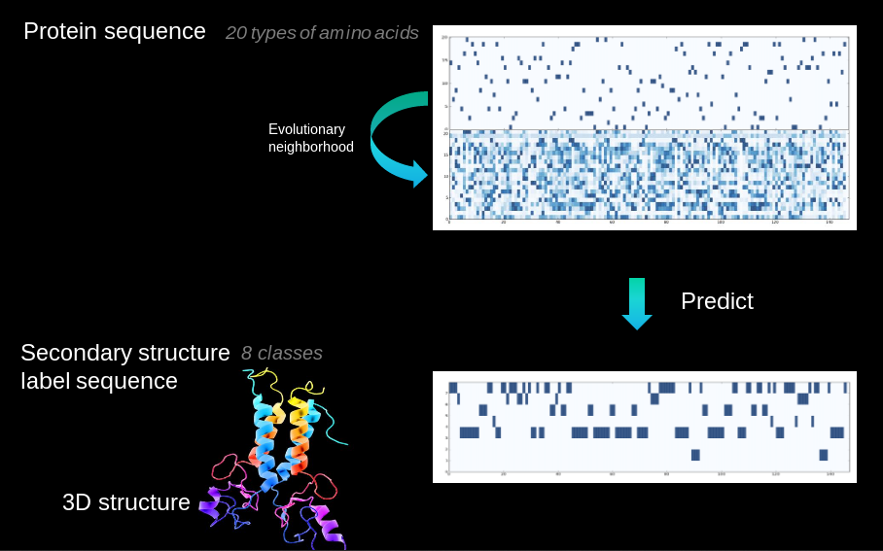
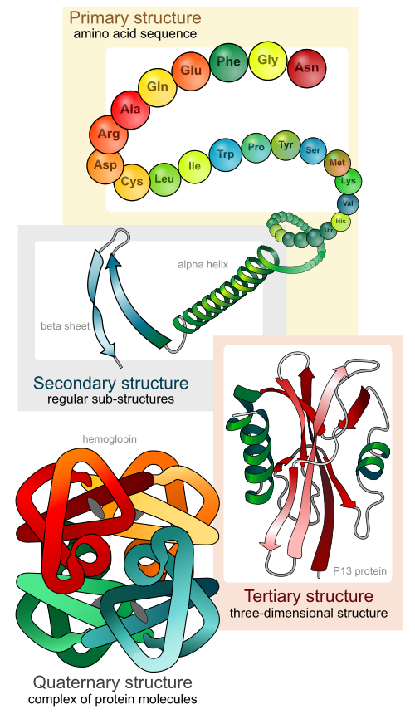
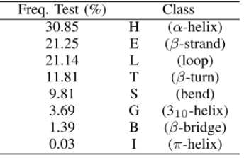
85M proteins discovered, 130k structure known
Notes:
- Proteins fold into 3D structure, which determines their function
- Drug, enzyme design,
- High cost of experimental protein structure determination and low cost of DNA sequencing
- 85M proteins discovered, 130k 2ary struct known
- Extremely challenging 3D from sequence alone
- Intermediate step (constrains): secondary structure, local conformations of peptide backbone alpha-helix (3), beta-strand (2), coil (3)
- Structural labelling: many-to-many sequence problem
- Other problems: backbone angle, contact number, solvent accesibility area. Many-to-one: intrinsic disorder prediction, subcellular area

Slide 3
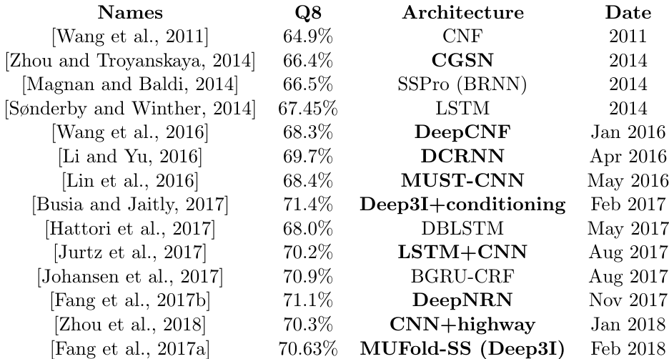
State of the art

Slide 4
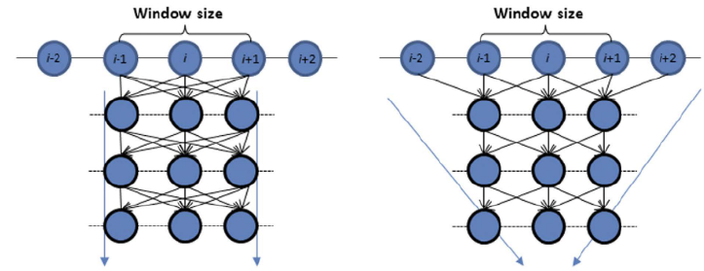
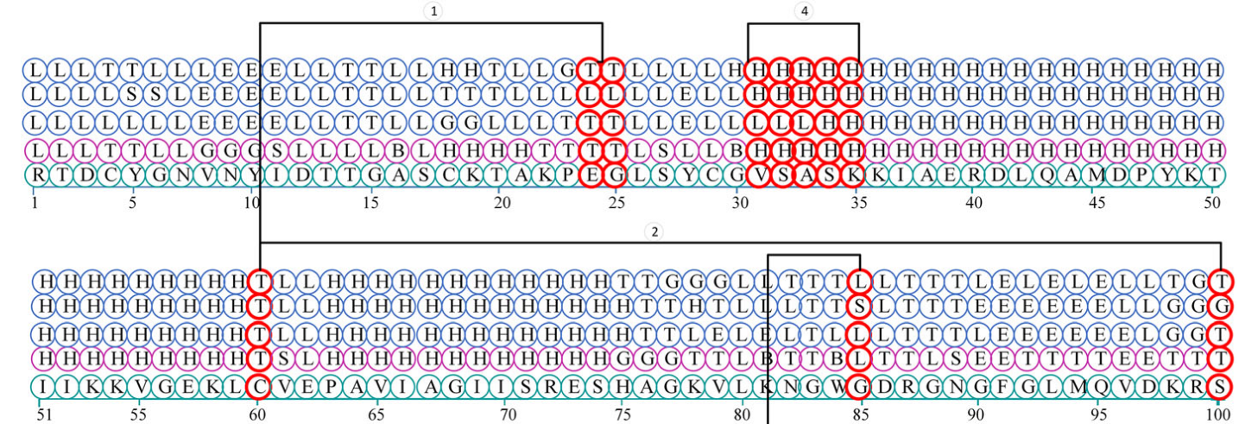
Why CNNs (and RNNs)?

Slide 5
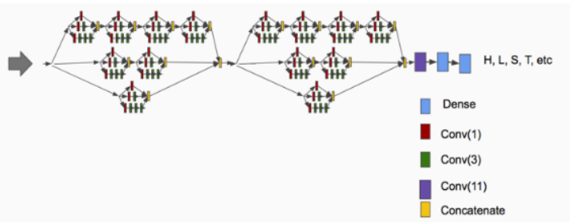
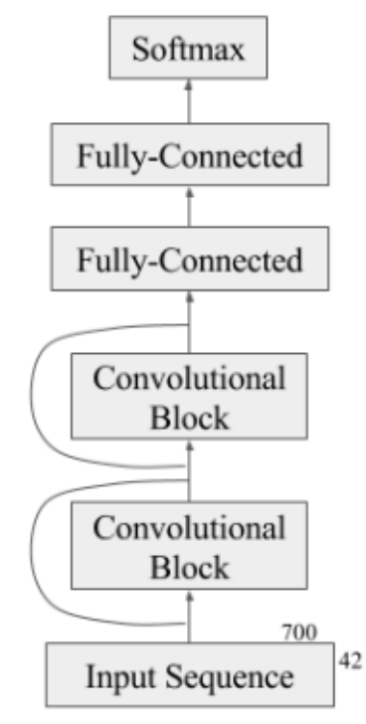
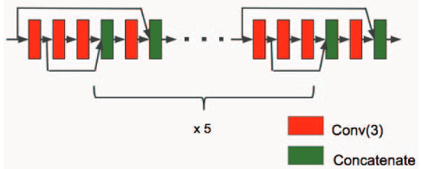
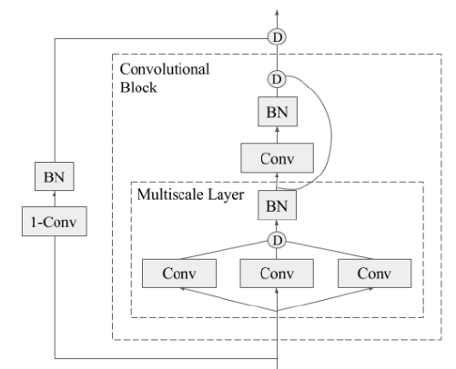
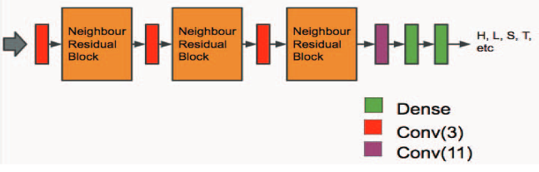
Winning architectures

Slide 6
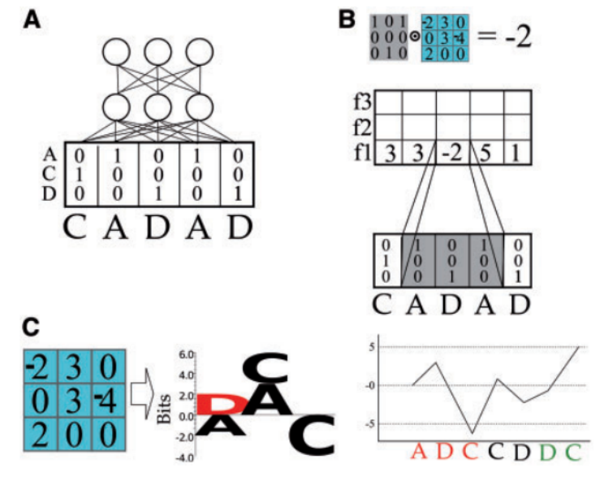
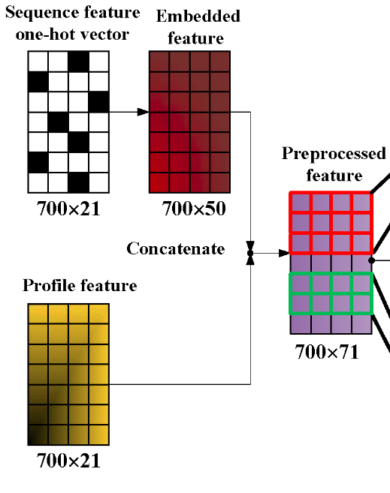
CNNs in protein sequences

Slide 7
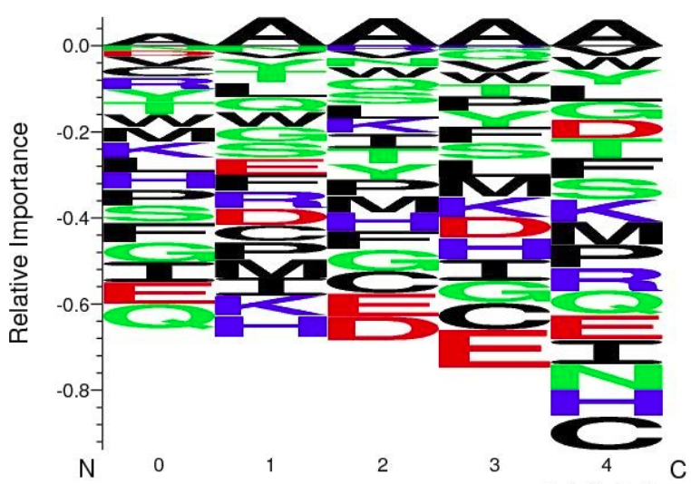
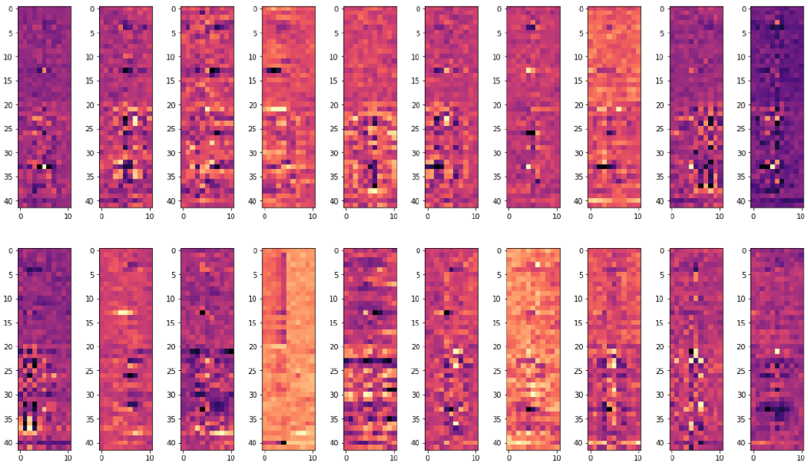
How can we interpret filters?

Slide 8


